Slide 1

Subject: FUNDAMENTALS OF iOS APPLICATION DEVELOPMENT WITH SWIFT
Module Number - 3
Module Name: Getting Started With App Development & Introduction to UIKit

Slide 2
UIKit Framework
Syllabus
Introduction to UIKit Framework
Controllers & Outlets
TextField
Label
Button
Switch
Text View
Segmented Control
Page Control
Image View
Slider
Stepper
ActivityIndicator View
Progress View
Web View
AlertController (Alert View & Action Sheet)
View
Tool Bar & BarButtonItem

Slide 3
UIKit Framework
AIM:
To understand the concept’s of Geting Started With App Development and UIKit Framework.

Slide 4
UIKit Framework
Objectives:
Study and understand the basics of App Development
Study and understand the UIKit Framework
Study and understand the concepts of User Interface Designing

Slide 5
UIKit Framework
Table of Contents:
Introduction to UIKit Framework
Controllers & Outlets
TextField
Label
Button
Switch
Text View
Segmented Control
Page Control
Image View
Slider
Stepper
ActivityIndicator View
Progress View
Web View
AlertController (Alert View & Action Sheet)
View
Tool Bar & BarButtonItem

Slide 6
Introduction To UIKit Framework
UIKit Framework
UIKit
Construct and manage a graphical, event-driven user interface for your iOS or tvOS app.
Overview
The UIKit framework provides the required infrastructure for your iOS or tvOS apps. It provides the window and view architecture for implementing your interface, the event handling infrastructure for delivering Multi-Touch and other types of input to your app, and the main run loop needed to manage interactions among the user, the system, and your app. Other features offered by the framework include animation support, document support, drawing and printing support, information about the current device, text management and display, search support, accessibility support, app extension support, and resource management.

Slide 7
UIKit Framework
1. User Interface
Views help you display content on screen and facilitate user interactions; view controllers help you manage views and the structure of your interface.
Views and Controls
Present your content onscreen and define the interactions allowed with that content.
View Controllers
Manage your interface using view controllers and facilitate navigation around your app's content.
View Layout
Use stack views to lay out the views of your interface automatically. Use Auto Layout when you require precise placement of your views.
Appearance Customisation
Add Dark Mode support to your app, customise the appearance of bars, and use appearance proxies to modify your UI.
Animation and Haptics
Provide feedback to users using view-based animations and haptics.
Windows and Screens
Provide a container for your view hierarchies and other content.

Slide 8
UIKit Framework
2. User Interactions
Responders and gesture recognizers help you handle touches and other events. Drag and drop, focus, peek and pop, and accessibility handle other user interactions.
Touches, Presses, and Gestures
Encapsulate your app's event-handling logic in gesture recognizers so that you can reuse that code throughout your app.
Drag and Drop
Bring drag and drop to your app by using interaction APIs with your views.
Pointer Interactions
Support pointer interactions in your custom controls and views.
Pencil Interactions
Handle double-tap user interactions on Apple Pencil.
Focus-based Navigation
Navigate the interface of your UIKit app using a remote or a game controller.
Menus and Shortcuts
Simplify interactions with your app using menu systems, contextual menus, Home screen quick actions, and keyboard shortcuts.
Accessibility for iOS and tvOS
Make your apps accessible to everyone who uses iOS and tvOS apps.

Slide 9
UIKit Framework
3. Graphics, Drawing, and Printing
UIKit provides classes and protocols that help you configure your drawing environment and render your content.
Images and PDF
Create and manage images, including those that use bitmap and PDF formats.
Drawing
Configure your app's drawing environment using colors, renderers, draw paths, strings, and shadows.
Printing
Display the system print panels and manage the printing process.

Slide 10
UIKit Framework
4. Text
In addition to text views that simplify displaying text in your app, UIKit provides custom text management and rendering that supports the system keyboards.
Text Display and Fonts
Display text, manage fonts, and check spelling.
Text Storage
Manage text storage and coordinate the layout of text.
Keyboards and Input
Configure the system keyboard, create your own keyboards to handle input, or detect key presses on a physical keyboard.
Handwriting Recognition
Configure text fields and custom views that accept text to handle input from Apple Pencil.

Slide 11
Controllers & Outlets
UIKit Framework
Controllers
You use view controllers to manage your UIKit app’s interface.
A view controller manages a single root view, which may itself contain any number of subviews.
User interactions with that view hierarchy are handled by your view controller, which coordinates with other objects of your app as needed.
Every app has at least one view controller whose content fills the main window. If your app has more content than can fit onscreen at once, use multiple view controllers to manage different parts of that content.

Slide 12
UIKit Framework
In Xcode StoryBoard File, the Object Library includes 9 different Controllers
1. UIViewController
An object that manages a view hierarchy for your UIKit app.
2. UITableViewController
A view controller that specialises in managing a table view.
3. UICollectionViewController
A view controller that specialises in managing a collection view.
4. UISplitViewController
A container view controller that implements a master-detail interface.
5. UINavigationController
A container view controller that defines a stack-based scheme for navigating hierarchical content.

Slide 13
UIKit Framework
6. UITabBarController
A container view controller that manages a radio-style selection interface, where the selection determines which
child view controller to display.
7. UIPageViewController
A container view controller that manages navigation between pages of content, where each page is managed by a
child view controller.
8. GLKViewController
A view controller that manages an OpenGL ES rendering loop.
9. AVKit Player ViewController
A controller that manages an AVPlayer object, which can display audiovisual content and standard playback controls.

Slide 14
UIKit Framework
Outlets
An outlet connection is created when you need to send a message from your code to a user interface object in Xcode’s storyboard.
The object can be a control, such as a button, a slider, and a switch, or it can be any other object defined in your storyboard, such as a label and a progress bar.
For example, when your code determines that a label should display some texts, the code sends a message through the outlet telling the label to display the new text.

Slide 15
TextField
UIKit Framework
Class
UITextField
An object that displays an editable text area in your interface.
Overview
You use text fields to gather text-based input from the user using the onscreen keyboard. The keyboard is configurable for many different types of input such as plain text, emails, numbers, and so on. Text fields use the target-action mechanism and a delegate object to report changes made during the course of editing.
In addition to its basic text-editing behavior, you can add overlay views to a text field to display additional information and provide additional tappable controls. You might add custom overlay views for elements such as a bookmarks button or search icon. Text fields provide a built-in overlay view to clear the current text. The use of custom overlay views is optional.

Slide 16

UIKit Framework
Swift Code to display TextField on UserInterface
var t1: UITextField!
t1 = UITextField()
// size inspector
t1.frame = CGRect(x: 100, y: 100, width: 150, height: 30)
// attributes
t1.backgroundColor = .white
t1.borderStyle = .roundedRect
t1.placeholder="enter text here"
t1.keyboardType = .default
t1.returnKeyType = .done
t1.isSecureTextEntry = true
t1.textColor = .black
t1.textAlignment = .center
// display textfield
self.view.addSubview(t1)

Slide 17
Label
UIKit Framework
Class
UILabel
A view that displays one or more lines of read-only text, often used in conjunction with controls to describe their intended purpose.
Overview
The appearance of labels is configurable, and they can display attributed strings, allowing you to customize the appearance of substrings within a label. You can add labels to your interface programmatically or by using Interface Builder.
The following steps are required to add a label to your interface:
Supply either a string or an attributed string that represents the content.
If using a non-attributed string, configure the appearance of the label.
Set up Auto Layout rules to govern the size and position of the label in your interface.
Provide accessibility information and localized strings.

Slide 18

UIKit Framework
Swift Code to display Label on UserInterface
var lab1: UILabel!
lab1 = UILabel()
// size inspector
lab1.frame = CGRect(x: 100, y: 150, width: 150, height: 30)
// attributes
lab1.backgroundColor = .brown
lab1.textAlignment = .center
lab1.textColor = .white
lab1.numberOfLines = 2
// display label
self.view.addSubview(lab1)

Slide 19

Button
UIKit Framework
Class
UIButton
A control that executes your custom code in response to user interactions.
Overview
When you tap a button, or select a button that has focus, the button performs any actions attached to it. You communicate the purpose of a button using a text label, an image, or both. The appearance of buttons is configurable, so you can tint buttons or format titles to match the design of your app. You can add buttons to your interface programmatically or using Interface Builder.

Slide 20
UIKit Framework
When adding a button to your interface, perform the following steps:
Set the type of the button at creation time.
Supply a title string or image; size the button appropriately for your content.
Connect one or more action methods to the button.
Set up Auto Layout rules to govern the size and position of the button in your interface.
Provide accessibility information and localized strings.

Slide 21

UIKit Framework
Swift Code to display Button on UserInterface
var b1: UIButton!
b1 = UIButton()
// size inspector
b1.frame = CGRect(x: 100, y: 250, width: 150, height: 30))
// attributes
b1.setTitle("clickhere", for: .normal)
b1.setTitleColor(.black, for: .normal)
b1.backgroundColor = .cyan
b1.addTarget(self, action: #selector(self.click1), for: .touchUpInside)
// display Button
self.view.addSubview(b1)
@objc func click1() {
// Implementation Code Here
}

Slide 22
Switch
UIKit Framework
Class
UISwitch
A control that offers a binary choice, such as On/Off.
Overview
The UISwitch class declares a property and a method to control its on/off state. As with UISlider, when the user manipulates the switch control (“flips” it) a valueChanged event is generated, which results in the control (if properly configured) sending an action message.
You can customize the appearance of the switch by changing the color used to tint the switch when it is on or off.

Slide 23
UIKit Framework
Swift Code to display Switch on UserInterface
var sw2: UISwitch!
sw2 = UISwitch()
sw2.frame = CGRect(x: 150, y: 300, width: 150, height: 40)
sw2.isOn = false
sw2.onTintColor = .yellow
sw2.thumbTintColor = .red
sw2.tintColor = .black
sw2.addTarget(self, action: #selector(SwitchClick2), for: .valueChanged)
self.view.addSubview(sw2)

Slide 24
TextView
UIKit Framework
Class
UITextView
A scrollable, multiline text region.
Overview
UITextView supports the display of text using custom style information and also supports text editing. You typically use a text view to display multiple lines of text, such as when displaying the body of a large text document.This class supports multiple text styles through use of the attributedText property. (Styled text is not supported in versions of iOS earlier than iOS 6.) Setting a value for this property causes the text view to use the style information provided in the attributed string. You can still use the font, textColor, and textAlignment properties to set style attributes, but those properties apply to all of the text in the text view. It’s recommended that you use a text view—and not a UIWebView object—to display both plain and rich text in your app.

Slide 25
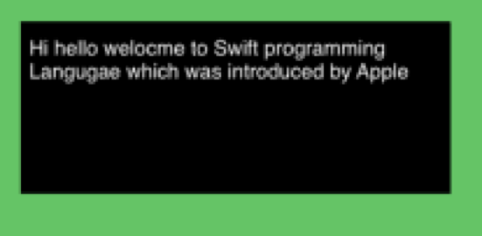
UIKit Framework
Swift Code to display TextView on UserInterface
var textView2: UITextView!
textView2 = UITextView()
// size inspector
textView2.frame = CGRect(x: 100, y: 350, width: 250, height: 100)
// attributes
textView2.backgroundColor = .black
textView2.textColor = .white
textView2.text = "Hi hello welcome to Swift programming Language which was introduced by Apple"
textView2.textAlignment = .left
textView2.isEditable = false
textView2.isSelectable = false
// display Button
self.view.addSubview(textView2)

Slide 26
Segmented Control
UIKit Framework
Class
UISegmentedControl
A horizontal control made of multiple segments, each segment functioning as a discrete button.
Overview
A segmented control can display a title (an NSString object) or an image (UIImage object). The UISegmentedControl object automatically resizes segments to fit proportionally within their superview unless they have a specific width set. When you add and remove segments, you can request that the action be animated with sliding and fading effects.
You register the target-action methods for a segmented control using the valueChanged constant as shown below.
segmentedControl.addTarget(self, action: "action:", forControlEvents: .valueChanged)

Slide 27
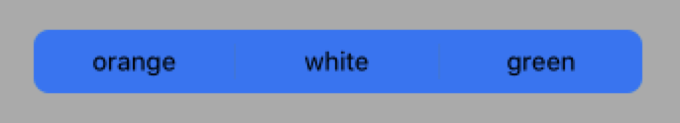
UIKit Framework
Swift Code to display SegmentedControl on UserInterface
var sc2: UISegmentedControl!
let arr1 = ["orange", "white", "green"]
sc2 = UISegmentedControl(items: arr1)
sc2.frame = CGRect(x: 100, y: 300, width: 250, height: 50)
sc2.backgroundColor = .cyan
sc2.tintColor = .black
sc2.selectedSegmentTintColor = . red
sc2.addTarget(self, action: #selector(segmentedControlClick2), for: .valueChanged)
self.view.addSubview(sc2)
@objc func segmentedControlClick() {
let i:Int = sc1.selectedSegmentIndex
if i==0 {
self.view.backgroundColor = .orange
}
else if i==1 {
self.view.backgroundColor = .white
}
else {
self.view.backgroundColor = .green
}
}

Slide 28
PageControl
UIKit Framework
Class
UIPageControl
A control that displays a horizontal series of dots, each of which corresponds to a page in the app’s document or other data-model entity.
Overview
For an example of a page control, see the Weather app when it's configured to display information for more than one location.When a user taps a page control to move to the next or previous page, the control sends the valueChanged event for handling by the delegate. The delegate can then evaluate the currentPage property to determine the page to display. The page control advances only one page in either direction. The currently viewed page is indicated by a white dot. Depending on the device, a certain number of dots are displayed on the screen before they are clipped.

Slide 29

UIKit Framework
Swift Code to display PageControl on UserInterface
var pc2: UIPageControl!
pc2 = UIPageControl()
pc2.frame = CGRect(x: 100, y: 300, width: 200, height: 50)
pc2.backgroundColor = .yellow
pc2.currentPage = 0
pc2.currentPageIndicatorTintColor = .red
pc2.tintColor = .black
pc2.numberOfPages = 3
pc2.addTarget(self, action: #selector(click2), for: .valueChanged)
self.view.addSubview(pc2)
@objc func click2() {
let j: Int = pc2.currentPage
if j == 0 {
// Implementation Code Here
}
else if j == 1 {
// Implementation Code Here
}
else {
// Implementation Code Here
}
}

Slide 30
ImageView
UIKit Framework
Class
UIImageView
An object that displays a single image or a sequence of animated images in your interface.
Overview
Image views let you efficiently draw any image that can be specified using a UIImage object. For example, you can use the UIImageView class to display the contents of many standard image files, such as JPEG and PNG files. You can configure image views programmatically or in your storyboard file and change the images they display at runtime. For animated images, you can also use the methods of this class to start and stop the animation and specify other animation parameters.

Slide 31

UIKit Framework
Swift Code to display Image on UserInterface
var iv1: UIImageView!
iv1 = UIImageView()
iv1.frame = CGRect(x: 50, y: 430, width: 200, height: 200)
iv1.image = UIImage(named: "12.jpg")
iv1.contentMode = .scaleAspectFit
iv1.backgroundColor = .black
self.view.addSubview(iv1)

Slide 32
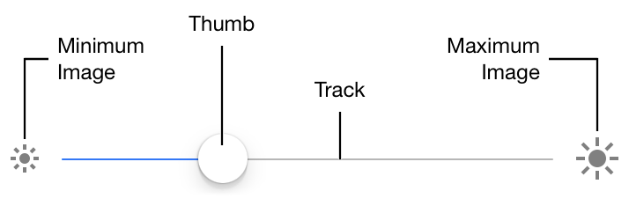
Slider
UIKit Framework
Class
UISlider
A control used to select a single value from a continuous range of values.
Overview
As you move the thumb of a slider, it passes its updated value to any actions attached to it. The appearance of sliders is configurable; you can tint the track and the thumb, and provide images to appear at the ends of the slider. You can add sliders to your interface programmatically or by using Interface Builder.
Figure 1 shows the terms used to describe the constituent parts of a UISlider object in a left-to-right configuration.

Slide 33
UIKit Framework
The following steps are required to add a slider to your interface:
Specify the range of values the slider represents.
Optionally, configure the appearance of the slippropriate tint colors, der with and limit images.
Connect one or more action methods to the slider.
Set up Auto Layout rules to govern the size and position of the slider in your interface.

Slide 34

UIKit Framework
Swift Code to display Slider on UserInterface
var slider2: UISlider!
slider2 = UISlider()
slider2.frame = CGRect(x: 50, y: 350, width: 280, height: 50)
slider2.minimumValue = 0
slider2.maximumValue = 1
slider2.value = 0.5
slider2.minimumTrackTintColor = .cyan
slider2.maximumTrackTintColor = .black
slider2.thumbTintColor = .red
slider2.backgroundColor = .brown
slider2.addTarget(self, action: #selector(sliderMove2), for: .valueChanged)
self.view.addSubview(slider2)
@objc func sliderMove2() {
// Implementation Code Here
}

Slide 35
Stepper
UIKit Framework
Class
UIStepper
A control used to increment or decrement a value.
Overview
If you set stepper behavior to “autorepeat” (which is the default), pressing and holding one of its buttons increments or decrements the stepper’s value repeatedly. The rate of change depends on how long the user continues pressing the control.
The maximum value must be greater than or equal to the minimum value. If you set a maximum or minimum value that would break this invariant, both values are set to the new value.
For example, if the minimum value is 200 and you set a maximum value of 100, then both the minimum and maximum become 200.

Slide 36
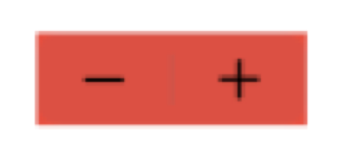
UIKit Framework
Swift Code to display Stepper on UserInterface
var stepper2: UIStepper!
stepper2 = UIStepper()
stepper2.frame = CGRect(x: 50, y: 300, width: 150, height: 40)
stepper2.backgroundColor = .green
stepper2.value = 0
stepper2.minimumValue = 0
stepper2.maximumValue = 20
stepper2.stepValue = 2
stepper2.addTarget(self, action: #selector(stepperClick2), for: .valueChanged)
self.view.addSubview(stepper2)
@objc func stepperClick2() {
// Implementation Code Here
}

Slide 37
ActivityIndicatorView
UIKit Framework
Class
UIActivityIndicatorView
A view that shows that a task is in progress.
Overview
You control when an activity indicator animates by calling the startAnimating() and stopAnimating() methods. To automatically hide the activity indicator when animation stops, set the hidesWhenStopped property to true.
You can set the color of the activity indicator by using the color property.

Slide 38

UIKit Framework
Swift Code to display UIActivityIndicatorView on UserInterface
var activity2: UIActivityIndicatorView!
var timer2: Timer!
activity2 = UIActivityIndicatorView()
activity2.frame = CGRect(x: 100, y: 200, width: 50, height: 40)
activity2.color = .red
activity2.style = .large
self.view.addSubview(activity2)
activity2.startAnimating()
timer2 = Timer.scheduledTimer(timeInterval: 10.0, target: self, selector: #selector(stopTimer2), userInfo: nil, repeats: true)
@objc func stopTimer2() {
activity2.stopAnimating()
activity2.hidesWhenStopped = true
}

Slide 39
ProgressView
UIKit Framework
Class
UIProgressView
A view that depicts the progress of a task over time.
Overview
The UIProgressView class provides properties for managing the style of the progress bar and for getting and setting values that are pinned to the progress of a task.
For an indeterminate progress indicator—or, informally, a “spinner”—use an instance of the UIActivityIndicatorView class.

Slide 40

UIKit Framework
Swift Code to display UIProgressView on UserInterface
var pv2: UIProgressView!
var timer2 : Timer!
pv2 = UIProgressView()
pv2.frame = CGRect(x: 40, y: 150, width: 200, height: 40)
pv2.progressViewStyle = .bar
pv2.progressTintColor = .orange
pv2.trackTintColor = .black
self.view.addSubview(pv2)
timer2 = Timer.scheduledTimer(timeInterval: 3.0, target: self, selector: #selector(stopTimer2), userInfo: nil, repeats: true)
@objc func stopTimer2() {
pv2.progress += 0.1
if pv2.progress == 1.0
{
self.view.backgroundColor = .brown
pv2.isHidden = true
timer2.invalidate()
}
}

Slide 41
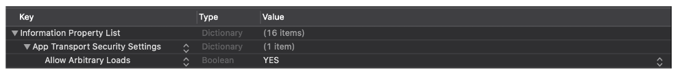
WebView
UIKit Framework
Class
WKWebView
An object that displays interactive web content, such as for an in-app browser.
Overview
You can use the WKWebView class to embed web content in your app. To do so, create a WKWebView object, set it as the view, and send it a request to load web content.
In Info.plist, Setup the Permissions
Add a row select App Transport Security Settings and set Allow Arbitrary Loads to YES.

Slide 42
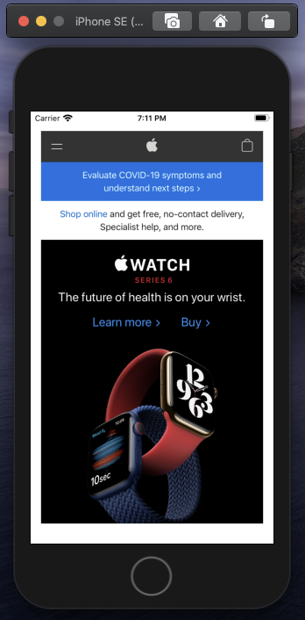
UIKit Framework
Swift Code to display WKWebView on UserInterface
import UIKit
import WebKit
class ViewController: UIViewController {
var webView2: WKWebView!
var url2: URL!
var request2: URLRequest!
override func viewDidLoad() {
super.viewDidLoad()
// Do any additional setup after loading the view.
//WebView COde
webView2 = WKWebView()
webView2.frame = CGRect(x: 10, y: 350, width: 300, height: 200)
self.view.addSubview(webView2)
url2 = URL(string: "https://www.apple.com")
request2 = URLRequest(url: url1 as URL)
webView2.load(request1 as URLRequest)
}
}

Slide 43
AlertController
UIKit Framework
Class
UIAlertController
An object that displays interactive web content, such as for an in-app browser.
Overview
Use this class to configure alerts and action sheets with the message that you want to display and the actions from which to choose. After configuring the alert controller with the actions and style you want, present it using the present(_:animated:completion:) method. UIKit displays alerts and action sheets modally over your app's content.
In addition to displaying a message to a user, you can associate actions with your alert controller to give the user a way to respond. For each action you add using the addAction(_:) method, the alert controller configures a button with the action details. When the user taps that action, the alert controller executes the block you provided when creating the action object.

Slide 44
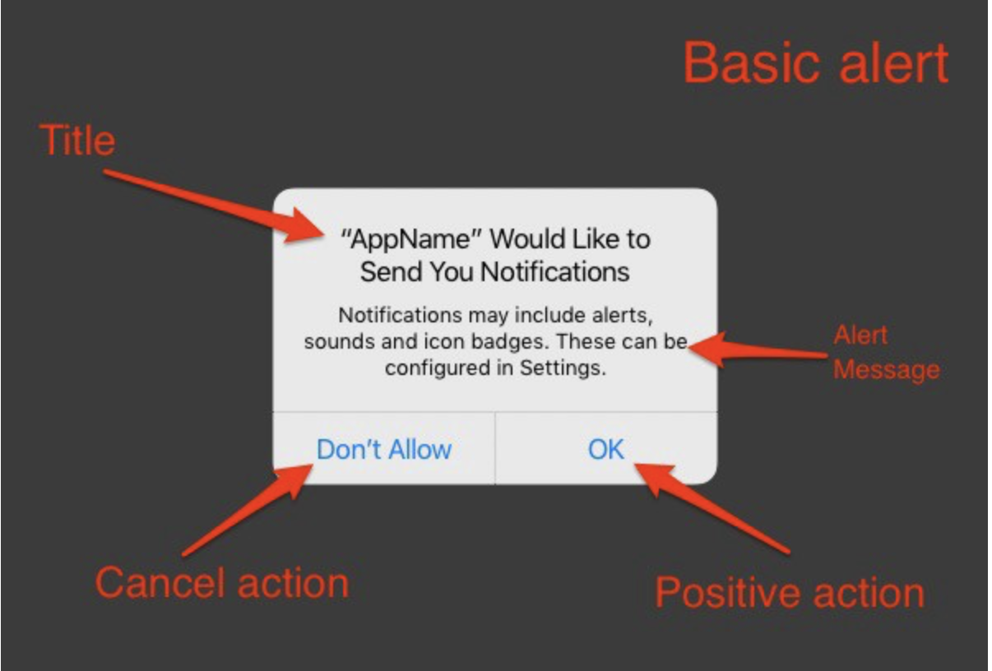
UIKit Framework
AlertView
UIAlertController is one of the most basic component of the app development, because using the UIAlertController to get the feedback, confirmation, choose between the options from the user, also we do alerts.
Components
1.Title : The title of the alert.
2. Alert Message : Descriptive text that provides more details about the reason for the alert.
3. Alert Style : Indicating the type of alert to display.
4. Alert Actions : The actions that the user can take in response to the alert or action sheet.

Slide 45
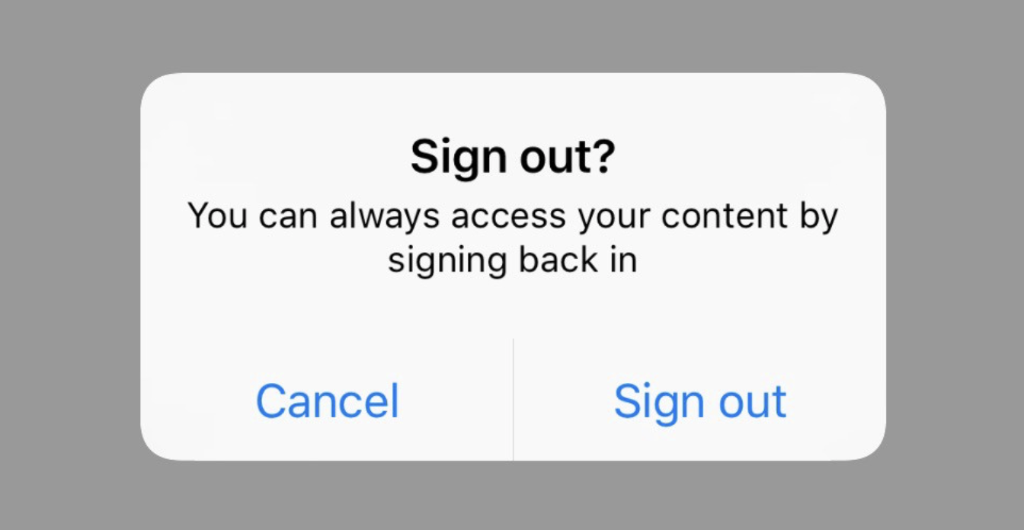
UIKit Framework
Simple Alert Syntax
let alert = UIAlertController(title: "Sign out?", message: "You can always access your content by signing back in", preferredStyle: .alert)
alert.addAction(UIAlertAction(title: "Cancel", style: .default, handler: { _ in
//Cancel Action
}))
alert.addAction(UIAlertAction(title: "Sign out",
style: .default,
handler: {(_: UIAlertAction!) in
//Sign out action
}))
self.present(alert, animated: true, completion: nil)
Output is

Slide 46
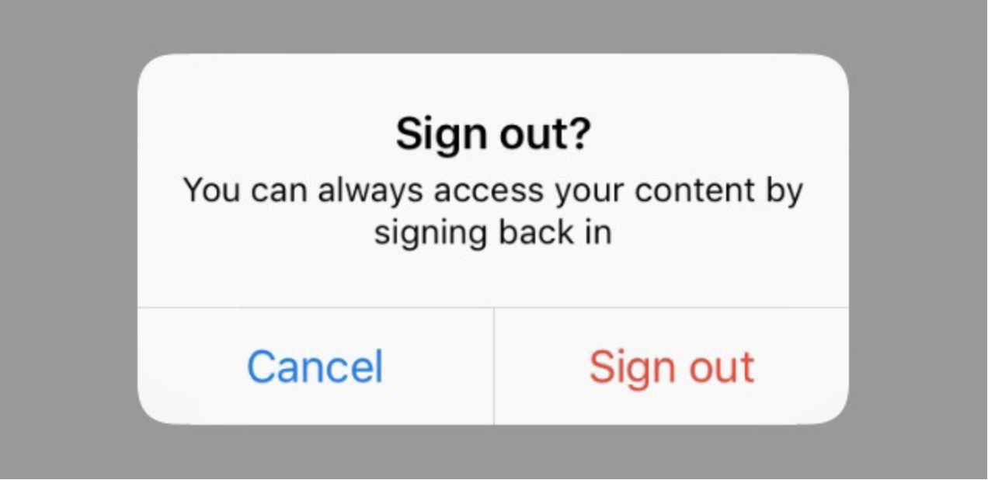
UIKit Framework
Alert with distractive button
let alert = UIAlertController(title: "Sign out?", message: "You can always access your content by signing back in", preferredStyle: .alert)
alert.addAction(UIAlertAction(title: "Cancel", style: .default, handler: { _ in
//Cancel Action
}))
alert.addAction(UIAlertAction(title: "Sign out",
style:.destructive,
handler: {(_: UIAlertAction!) in
//Sign out action
}))
self.present(alert, animated: true, completion: nil)
Output is

Slide 47
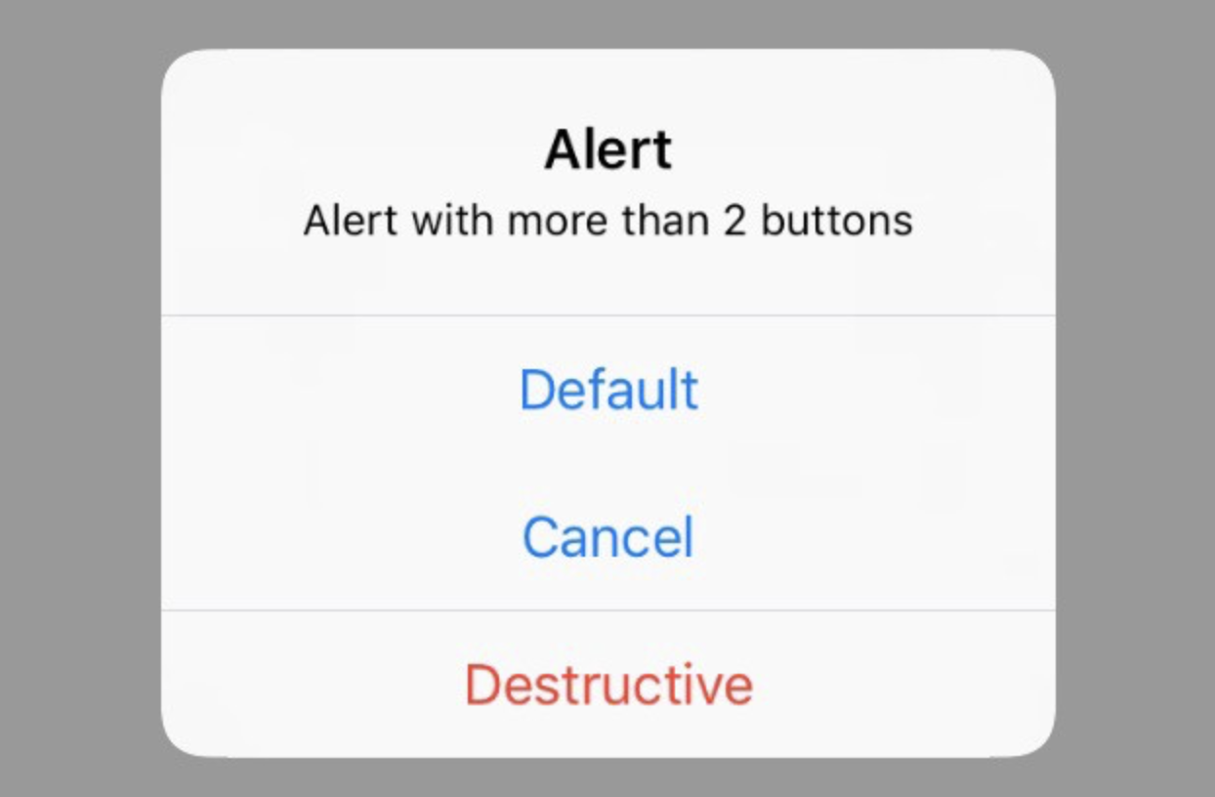
UIKit Framework
Alert with more than 2 buttons
let alert = UIAlertController(title: "Alert", message: "Alert with more than 2 buttons", preferredStyle: .alert)
alert.addAction(UIAlertAction(title: "Default", style: .default, handler: { (_) in
print("You've pressed default")
}))
alert.addAction(UIAlertAction(title: "Cancel", style: .default, handler: { (_) in
print("You've pressed cancel")
}))
alert.addAction(UIAlertAction(title: "Destructive", style: .destructive, handler: { (_) in
print("You've pressed the destructive")
}))
self.present(alert, animated: true, completion: nil)
Output is

Slide 48
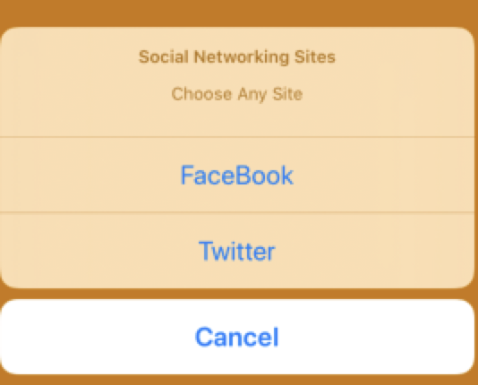
UIKit Framework
ActionSheet Syntax
let optionMenu = UIAlertController(title: "Social Networking Sites", message: "Choose Any Site”, preferredStyle: .actionSheet)
// create an action
let fbAction: UIAlertAction = UIAlertAction(title: "FaceBook", style: .default) { action -> Void in
print("First Action pressed")
}
let twitterAction: UIAlertAction = UIAlertAction(title: "Twitter", style: .default) { action -> Void in
print("Second Action pressed")
}
let cancelAction: UIAlertAction = UIAlertAction(title: "Cancel", style: .cancel) { action -> Void in }
optionMenu.addAction(fbAction)
optionMenu.addAction(twitterAction)
optionMenu.addAction(cancelAction)
// 5
self.present(optionMenu, animated: true, completion: nil)

Slide 49
View
UIKit Framework
Class
UIView
An object that manages the content for a rectangular area on the screen.
Overview
Views are the fundamental building blocks of your app's user interface, and the UIView class defines the behaviors that are common to all views.
A view object renders content within its bounds rectangle and handles any interactions with that content. The UIView class is a concrete class that you can instantiate and use to display a fixed background color. You can also subclass it to draw more sophisticated content.
To display labels, images, buttons, and other interface elements commonly found in apps, use the view subclasses provided by the UIKit framework rather than trying to define your own.

Slide 50
UIKit Framework
Because view objects are the main way your application interacts with the user, they have a number of responsibilities. Here are just a few:
Drawing and animation
Views draw content in their rectangular area using UIKit or Core Graphics.
Some view properties can be animated to new values.
Layout and subview management
Views may contain zero or more subviews.
Views can adjust the size and position of their subviews.
Use Auto Layout to define the rules for resizing and repositioning your views in response to changes in the view hierarchy.
Event handling
A view is a subclass of UIResponder and can respond to touches and other types of events.
Views can install gesture recognizers to handle common gestures.

Slide 51

UIKit Framework
Swift Code to display View on UserInterface
var view2: UIView!
var view2Label: UILabel!
// view code
view2 = UIView()
view2.frame = CGRect(x: 20, y: 400, width: 300, height: 200)
view2.backgroundColor = .cyan
view2.isHidden = false
// label code
view2Label = UILabel()
view2Label.frame = CGRect(x: 30, y: 40, width: 100, height: 30)
view2Label.backgroundColor = .blue
view2Label.textAlignment = .center
view2.addSubview(view2Label)
self.view.addSubview(view2)

Slide 52
ToolBar & BarButtonItem
UIKit Framework
UIToolbar
A control that displays one or more buttons along the bottom edge of your interface.
Overview
To create toolbar items, use the UIBarButtonItem class. To add toolbar items to a toolbar, use the setItems(_:animated:) method. Toolbar images that represent normal and highlighted states of an item derive from the image you set using the inherited image property from the UIBarItem class. The image is colored with the toolbar’s tintColor. If you need radio button style controls, use the UITabBar class instead of UIToolbar.
Class
UIBarButtonItem
A button specialized for placement on a toolbar or tab bar.
Overview
You typically use Interface Builder to create and configure bar button items.

Slide 53
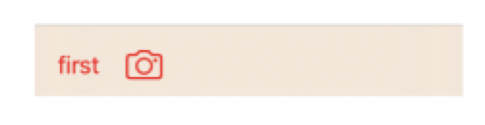
UIKit Framework
Swift Code to display Toolbar & BarButtonItem on UserInterface
var toolbar2: UIToolbar!
var b4: UIBarButtonItem!
var b5: UIBarButtonItem!
toolbar2 = UIToolbar()
toolbar2.frame = CGRect(x: 50, y: 350, width: 300, height: 50)
toolbar2.backgroundColor = .brown
toolbar2.tintColor = .red
b4 = UIBarButtonItem(title: "first", style: .plain, target: self, action: #selector(click4))
b5 = UIBarButtonItem(barButtonSystemItem: .camera, target: self, action: #selector(click5))
let arr1: Array = [b4, b5]
toolbar2.setItems(arr1 as? [UIBarButtonItem], animated: true)
self.view.addSubview(toolbar2)
@objc func click4() {
self.view.backgroundColor = . yellow
}
@objc func click5() {
self.view.backgroundColor = . blue
}

Slide 54
UIKit Framework
Assignment
Write a program to Display Digital Clock Using Date & DateFormatter.
Develop an app to display an Image & Increase or Decrease the Brightness of an Image.

Slide 55
UIKit Framework
Document Links
Topics | URL | Notes
Swift Pragramming Language | https://swift.org/ | Give the information to learn Swift Programming Language
UI Designing Concepts | https://developer.apple.com/documentation/ | UI Designing Concepts

Slide 56
UIKit Framework
E-Book Links
https://swift.org/
https://developer.apple.com/documentation/

